Slide 1

Tamer
project
Kang HoJung

Slide 2
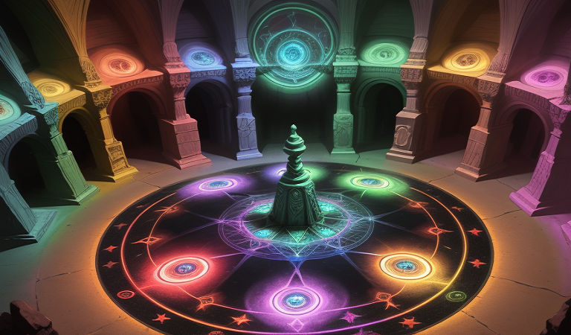
Content
Introduction (3p)
Goal (4p)
Used item (5p)
In Game (6p ~ 27p)
Now (28p)
Source (29p)
QnA (30p)
2

Slide 3

Introduction
- What’s Tamer?
Arcade game with puzzle elements
Most image created with AI
Using Flutter with Android Studio
Widgets that consider the user's display

Slide 4
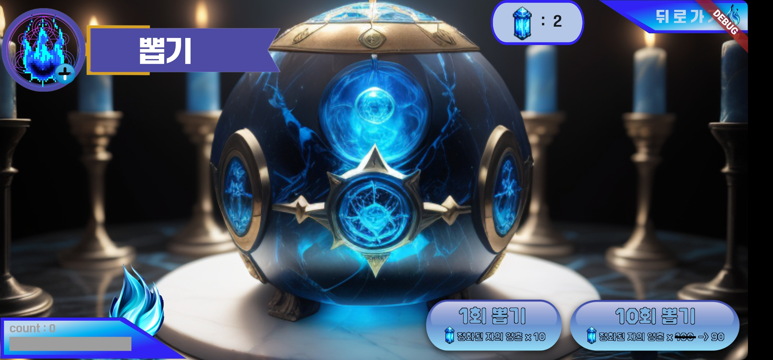
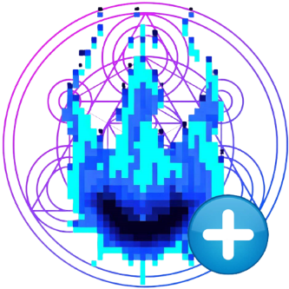
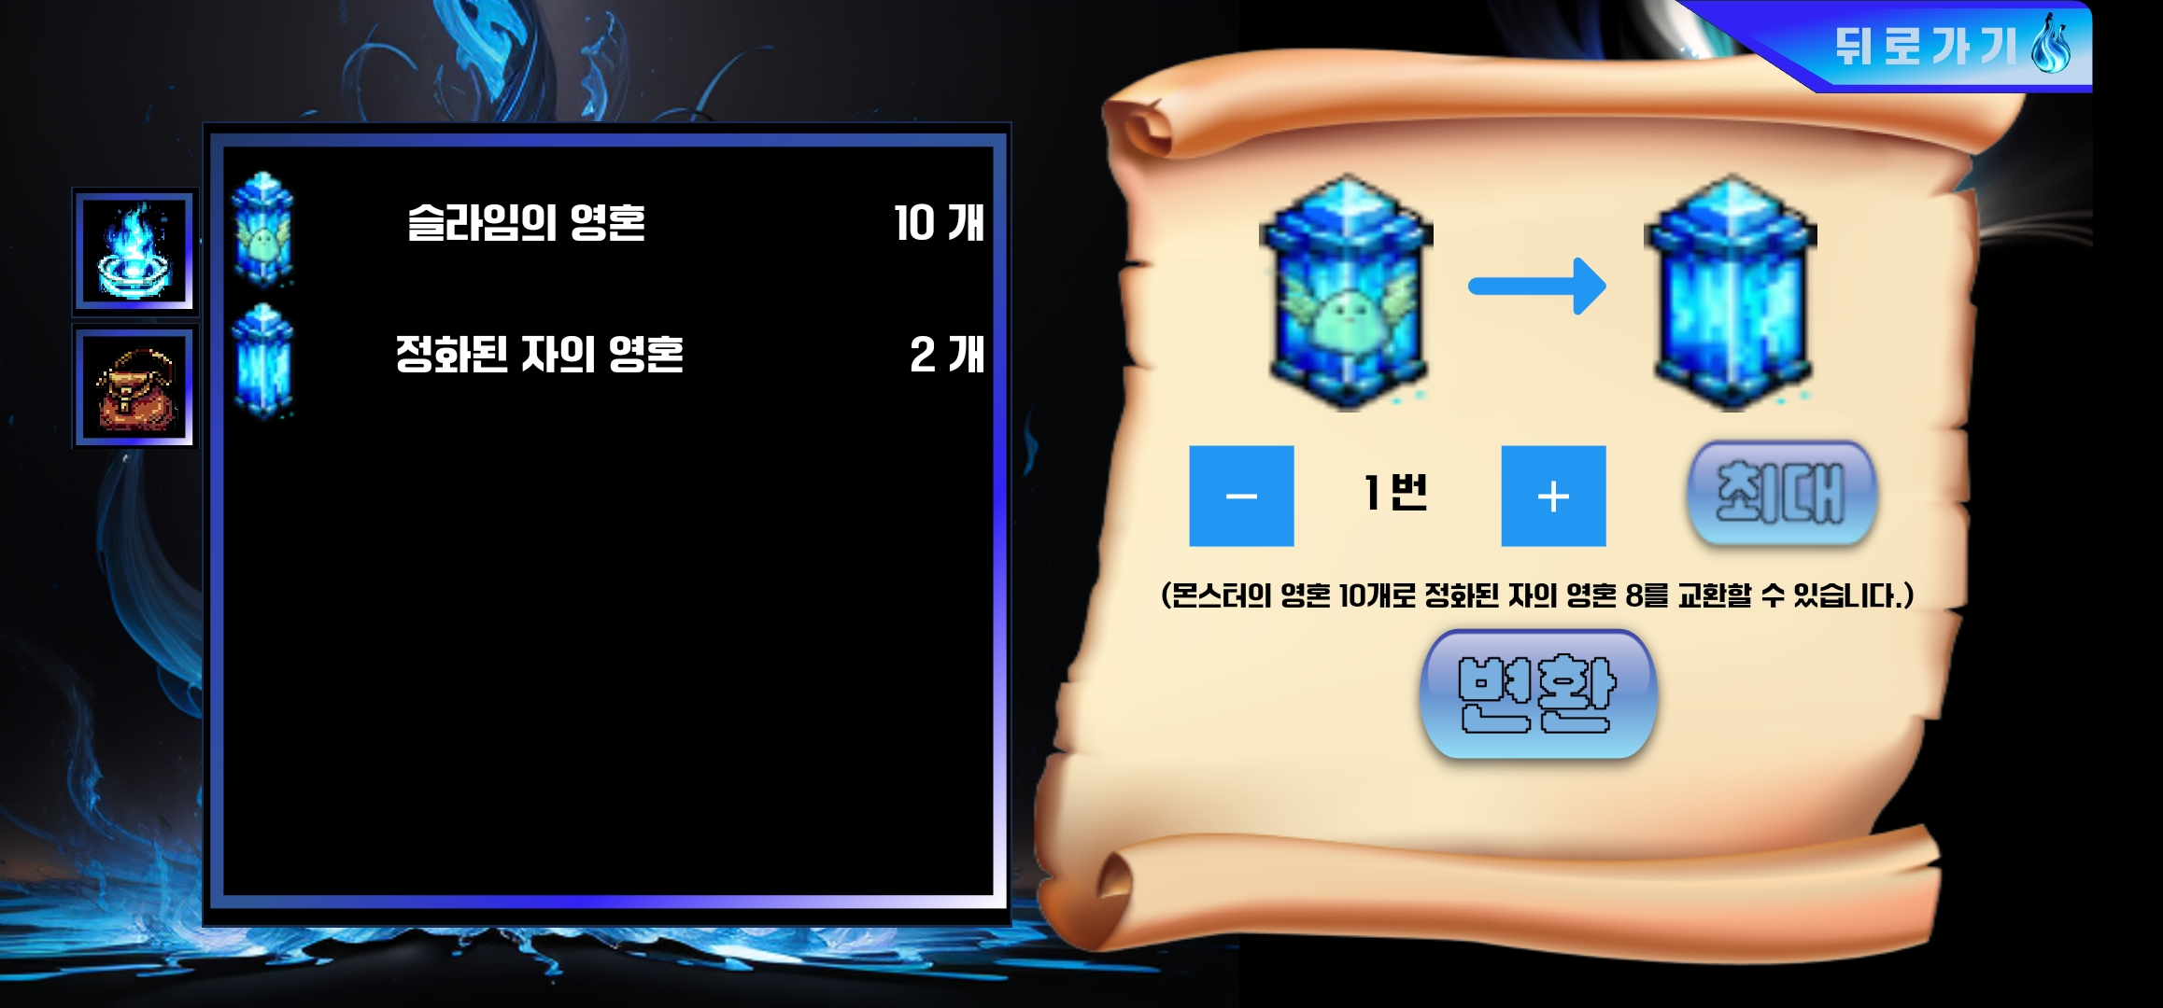
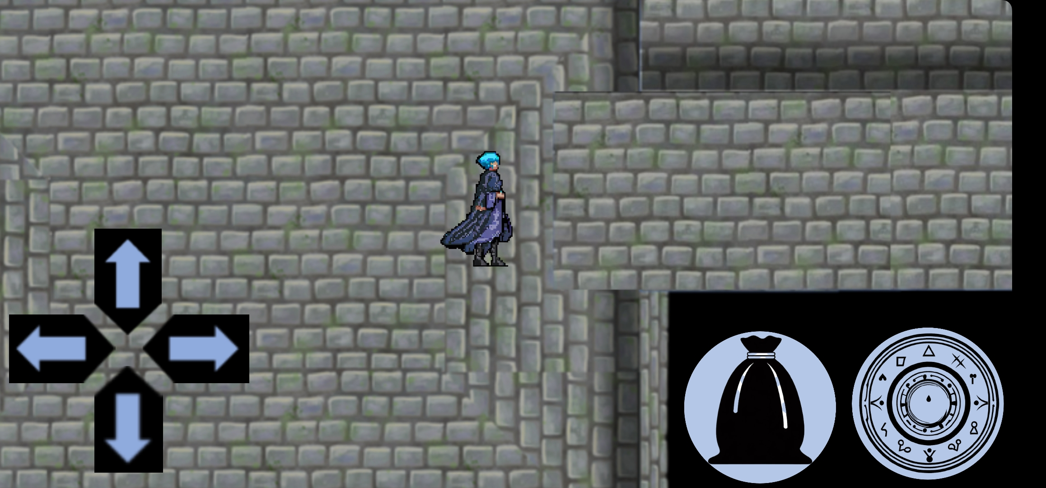


Goal
Pick up
- pity system
- duplicate draw
2. Inventory
- item’s conversion
- used item
3. Dungeon
- character move
- movement restrictions

Slide 5









Used item
Image
Language
& Framework
Etc.
Bing Image Creator
SQLite
Dart
Pokeit
Android Studio
Flutter
Removebg
Google Play Console
Adobe Express

Slide 6
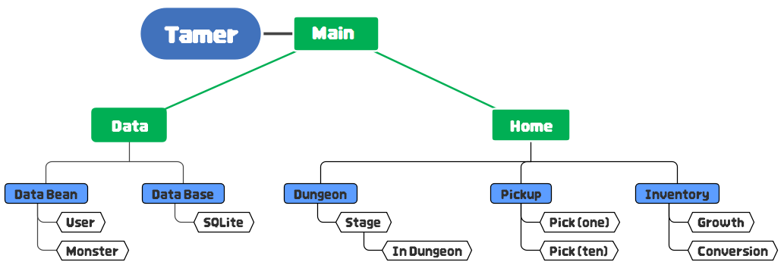
In Game
1
Main
2
Home
3
Data

Slide 7
DataBase
SQL Dataset
Data
Conversion
…
String? souls_name; String? souls_level; …
Data
Conversion
User Information
Data Table
… Map<String, int> user_souls; …
…
souls_name TEXT , souls_level TEXT , …

Slide 8
Data Conversion
Load data
-- souls –
Map<String, int> souls = {};
List<String> souls_name = info[0]['souls_name'].split(','); String souls_level_st = info[0]['souls_level']; List<int> souls_level = souls_level_st.split(',').map((value) => int.parse(value.trim())).toList();
for (int i = 0; i < souls_name.length; i++) { souls['${souls_name[i]}'] = souls_level[i]; }
Save data
-- souls –
String souls_name = user.user_souls.keys.toList().join(','); String souls_level = user.user_souls.values.toList().join(',');

Slide 9
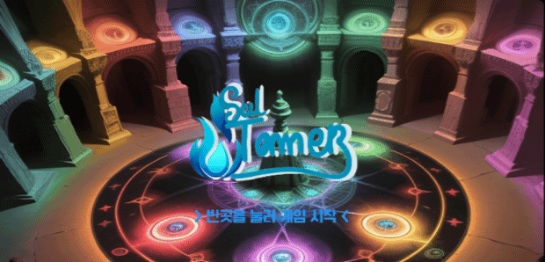
Main
1. Create user
- database create
2. Delete user
- database delete
3. Start
-database select

Slide 10
1
Widgets
OverlayEntry? select_user; OverlayEntry? messege; OverlayEntry? delete_overlay; OverlayEntry? complete;
Future<void> mission_complete(BuildContext context, String messege) async { complete = OverlayEntry( builder: (context) => Center( … )
2
DataBase
Future<void> _addData(String name) async { final db = await _initeDB(); await db.insert('tamer',{'name': name,},); setState(() {inputtext.clear();});}
Future<void> _deleteData(int id, int slot_id) async { final db = await _initeDB(); await db.delete('tamer', where: 'id=?', whereArgs: [id],); setState(() { for (String key in slot_on.keys) { slot_on[key] = false; } });}
Future<void> _loadData() async { final db = await _initeDB(); final datalist = await db.query('tamer'); setState(() {dataList = datalist;});}

Slide 11
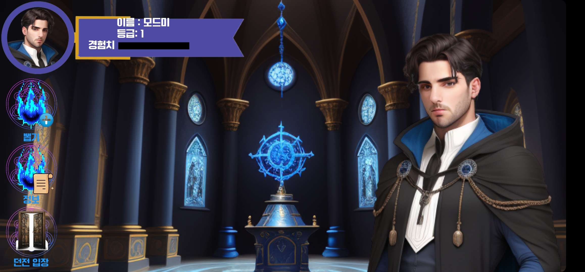
Home
1. Pickup
- once
- ten times
2. Inventory
- souls growth
- item conversion
3. Dungeon
-entry dungeon

Slide 12

1
onTap : Navigator
-- Pick page --
Navigator.push(context,MaterialPageRoute( builder: (context) => Pickscreen(widget.user)));
-- Inventory page --
Navigator.push(context,MaterialPageRoute( builder: (context) => Inforscreen(widget.user)));
-- Dungeon page --
Navigator.push(context, MaterialPageRoute( builder: (context) => dungeon_main(widget.user)));
2
User information
Text('이름 : ${widget.user.user_name} \n등급: ${widget.user.user_level}', style: TextStyle(fontSize: 13.0, color: Colors.white),),
Container(width: MediaQuery.of(context).size.width / 5, child: Row(children: [ Text('경험치 ', style: TextStyle(fontSize: 13.0, color: Colors.white),), Stack(children: [ Container(width: 100,height: 10,color: Colors.black,), Container(width: 0 + (100 * (widget.user.user_exp / widget.user.user_max_exp)),height:10,color:Colors.yellow,)],)],),),

Slide 13
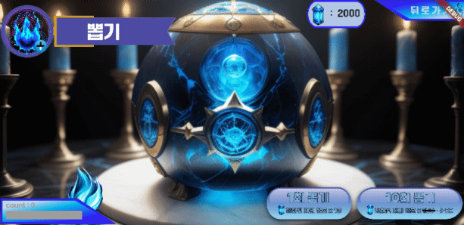
Pickup
1. Pick Type
- Ten times
- once
2. Counter

Slide 14

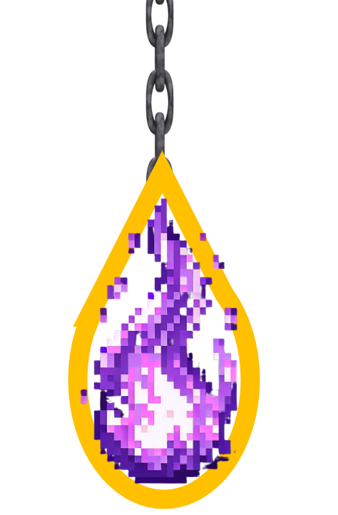
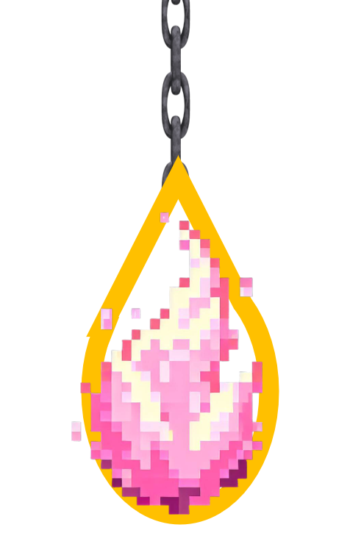
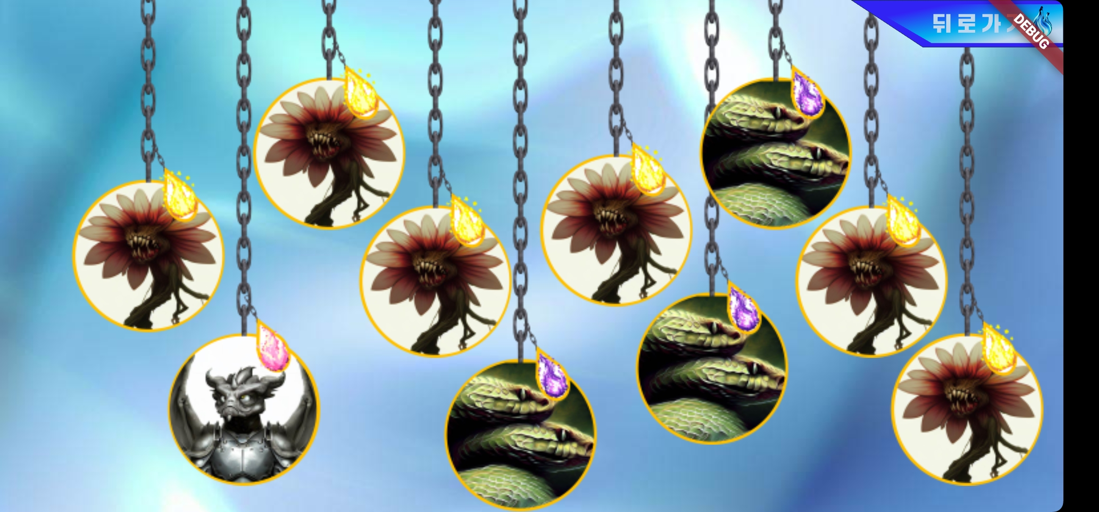
1
Pick result
for (int i = 1; i <= 10; i++) { pick = (Random().nextInt(30)) + 1; if (pick <= 15) {
this.pickresult = Grade['nomal']![nomal_ran]; this.count += 1; } else if (pick > 15 && pick <= 25) {
this.pickresult = Grade[‘rare']![nomal_ran]; this.count += 1; } else if (pick > 25) { this.pickresult = Grade[‘unique']![nomal_ran]; this.count = 0; }

Slide 15
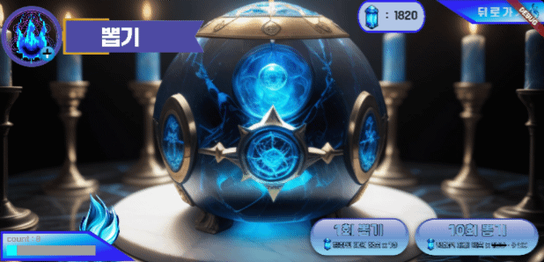
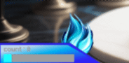
2
Counter
if (count >= 70) { this.pickresult = Grade['unique']![unique_ran]; this.pickresult_ten.add(this.pickresult); this.count = 0;

Slide 16
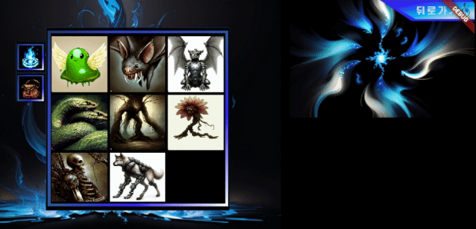
Inventory
1. Soul information
- level up
2. Item information
-conversion

Slide 17
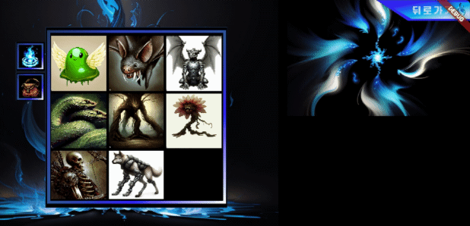

1
Soul information
Map <String, int> inven =widget.user.user_inventory;
Map <String, int> souls =widget.user.user_souls;
if(inven.containsKey(Name)){ if (inven[Name]! > (5 +(souls['${Name}']! - 1) *4) && souls['$Name']! <10) { setState(() { inven['$Name'] = (inven['$Name'] ?? 0) - (5 +(souls['${Name}']! - 1) *4); souls['${Name}'] = (souls['${Name}'] ?? 0) + 1; if (souls[Name]! < 10) {max_exp = (5 + (souls[Name]! - 1) * 4); } else {max_exp = '최대 레벨에 도달했습니다.’;}
if(inven[Name] == 0){inven.remove(Name); inventory.remove(Name);}

Slide 18

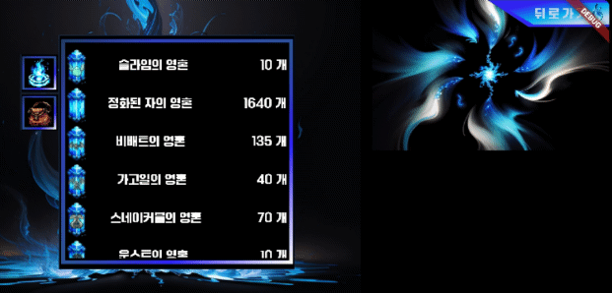
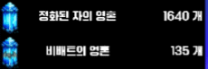
2
Item information
for (String name in widget.user.user_inventory.keys) {
inventory[name] = … Widget Configuration … }
Column(children: inventory.values.toList(),),
1. Decrease function
if (item_amount <= 0) {item_amount -= 0;}
else {item_amount -= 1;}
2. Increase function
if (item_amount >= widget.user.user_inventory[Name]!~/10) { item_amount += 0; } else {item_amount += 1;}
3. Max function
item_amount =widget.user.user_inventory[Name]! ~/10;

Slide 19
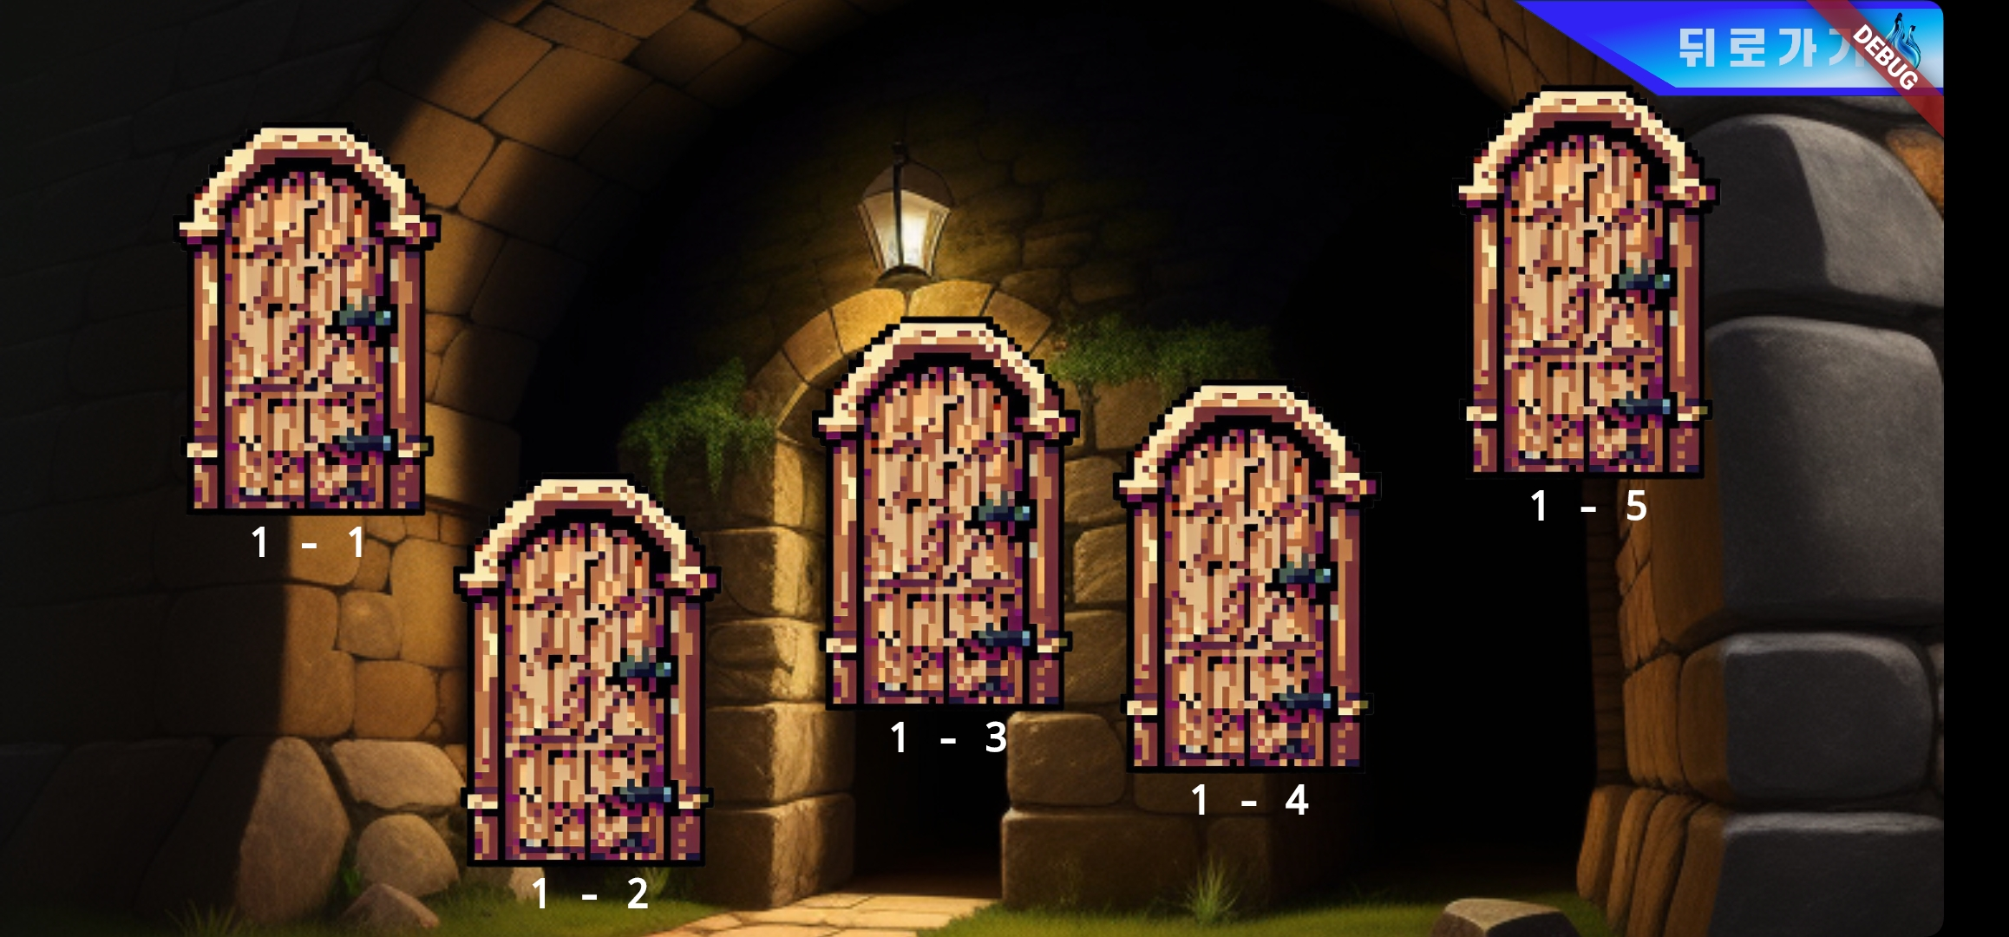
Dungeon (before entry)
1. Stage entry
-dungeon entry

Slide 20
1
dungeon entry
onTap: () async { Map<String, dynamic> result = await Navigator.push( context, MaterialPageRoute( builder: (context) => oneandone( user_info: widget.user,))); setState(() { for (String soul in result['clear_reward'].keys) { widget.user.user_inventory['$soul'] = ((widget.user.user_inventory['$soul'] ?? 0) + result['clear_reward']['$soul']).toInt();} widget.user.user_clear['1-1'] = result['clear_result']; widget.user.user_exp += result['exp'] as int; widget.user.levelup(); if (widget.user.user_clear['1-1'] == true) { door_1 = 'asset/image/dungeon_clear.png'; } else {door_1 = 'asset/image/dungeon_not_clear.png';}}); }},

Slide 21
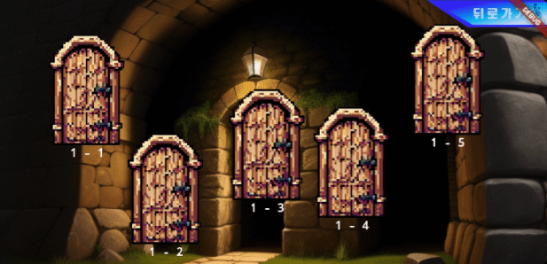
Dungeon (after entry)
1. Move limits
- coordinate limits
2. Action
- coordinate setting
3. Battle entry
-random skill

Slide 22
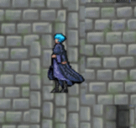
1
Move
void move(int ch_botton, int ch_left, String standing, String work) {
_timer = Timer.periodic(Duration(milliseconds: 150), (timer) { setState(() { botton_point += ch_botton; left_point += ch_left; limit_point(); count += 1; if (count % 2 == 0) {nomal_standing = standing;}
else if (count % 2 != 0) {nomal_standing = work;}});

Slide 23
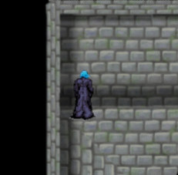
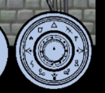
2
Coordinate limits
left_point = left_point.clamp(-2150, 295); if (left_point >= -285 && botton_point <= -1430) {botton_point = -1430;} if (left_point >= -285 && botton_point >= -990) { botton_point = -990;} … more …
3
Action coordinate setting
if (left_point <= -1785 && left_point >= -1965 && botton_point <= -1150 && botton_point >= -1260) { if (clear_1 == 1) { ran_skill(); int result_1 = await Navigator.push(context, MaterialPageRoute( builder: (context) => one_one_battle(widget.user_info, skill)));
… more …

Slide 24
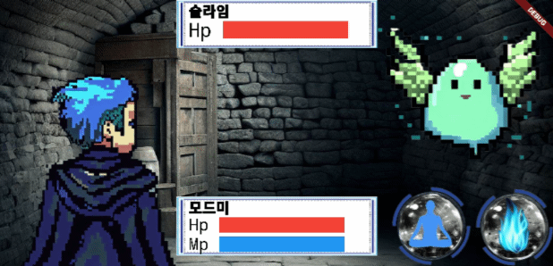
Battle
1. Skill
- soul skill
- meditation
2. State
- user & monster

Slide 25
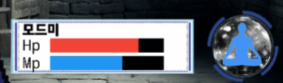
1
Skill
-- Soul skill -- fight battle = fight(); battle.Battle( user, slime, widget.skill_list[0], user_lavel);
-- Meditation -- if(click_medi) {fight().meditation(this.user, this.slime);
2
Battle
void Battle(User user, Slime slime, String soul, int level) { user.attack_process(soul, level); if (user.Mp_leftover != 'Empty') { slime.damage_process(user.attack_info); while (true) { if (slime.survival == 'death') { break;}
else { Monster_Attack(user, slime); user.status_process(slime.attack_info); slime.status_process(user.attack_info); if (user.survival == 'death’) { break; } break;

Slide 26
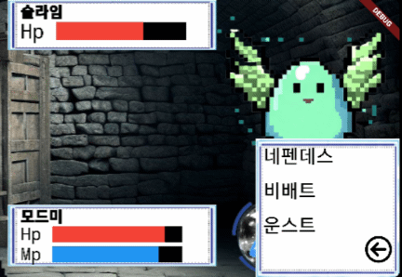
3
Skill attack calculation
3
Mp_leftover = ''; if (soul == 'goblin') { if (Mp >= 20) { Mp -= 20; attack_info['attack_point']!.add(10+(2*level)); } else { Mp_leftover = 'Empty'; } } else if (soul == 'nepenthes'){ if(Mp>= 15){Mp -= 15;attack_info['attack_point']!.add(7+level); int ran = Random().nextInt(5)+1; if( ran ==1){attack_info['activate']!['poisoned'] = 2;} }else{ Mp_leftover = 'Empty';}
-- Status ailment –
if (state == 'poisoned') {Hp -= (HpMax / 10).toInt();}
4
Damage calculation
4
if (attack_infos['attack_point'].isNotEmpty) { for (int damage_p in attack_infos['attack_point']) { damage += (damage_p - (damage_p * (defense / 100))).toInt(); }
Hp -= damage;}
if (Hp <= 0) {survival = 'death';} attack_infos['attack_point'].clear();

Slide 27
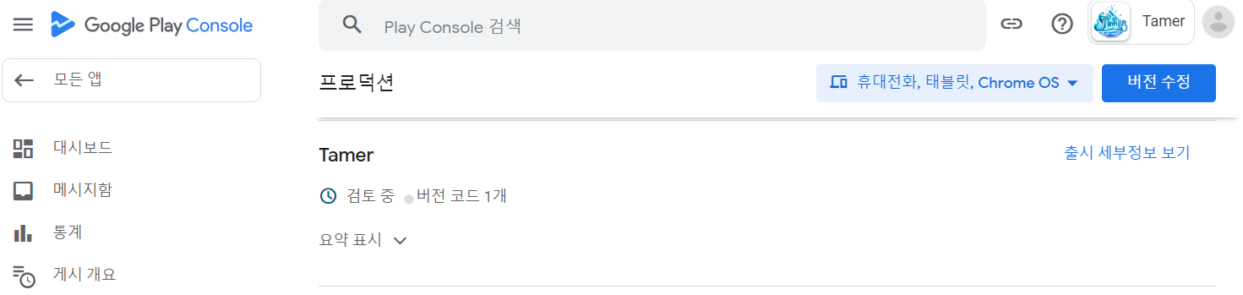
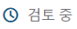
Now...
How can I test it?
Modeumi-@naver.com
+82 10-9604-9584
27

Slide 28



Source
Pick up page
Story of the queen (김현정/ 한국저작권위원회)
https://gongu.copyright.or.kr/gongu/wrt/wrt/view.do?wrtSn=
13073797&menuNo=200020
Others
Youtube 브금대통령[BGM President]
https://www.youtube.com/@bgmpresident
Bing Image Creator
https://www.bing.com/create
Pokeit
https://pokeit.ai/
Removegb
https://www.remove.bg/ko
Adobe Express
https://www.adobe.com/kr/express/create/logo/text

Slide 29

QnA

Slide 30

THANK
YOU

